Slide 1

Energy Demand Analysis & Forecasting
Weekly demand

Slide 2
OUTLINE
Project Statement
Motivation
Stakeholders
The Datasets
EDA Insights
Statistical Tests
Prediction Models

Slide 3

Project Statement
“PREDICTING TOTAL ENERGY DEMAND (MW) PER WEEK OF YEAR IN SPAIN BASED ON WEATHER FEATURES”

Slide 4

Motivation “Energy Demand Prediction Will Save Years of Earth Life Span and Resources ”

Slide 5

Over Supply of Energy
Under Supply of Energy
Short Term Implications
Choke supply grid
Hours of power cuts
Wasted energy production cost
Safety concerns
Lower energy prices
Difficult to maintain/operate energy sources
1) Not enough energy
Hours of power cuts
Economic impact
Safety concerns
2) Higher energy prices
Unaffordable prices for me and you.

Slide 6

Short Term Benefits
Trade off between:
Surplus in Generation and Lower Prices
Deficit in Generation and Higher Prices
Forecasting energy demand avoids the trade off altogether
It’s better to live with just the right energy at just the right price

Slide 7
Long Term Benefits
If we know how much we need
We know how much to generate
Advantages:
No wasted energy → Resources will last longer
No wasted energy → Lower carbon emissions → Increase earth life span

Slide 8

Stakeholders
Ministry of Energy
Energy Corporations
Energy regulation review
Economic indicator
Carbon emission prediction
Plan buying/selling to aid energy deficit/surplus
Plan magnitude of energy generation
Plan energy generation distribution

Slide 9

The Datasets
Energy Data
Represents all of Spain
Energy Demand by the Hour
Energy Generation for All Available Source by the Hour
Energy Prices by the Hour
Weather Data
5 Major Cities in Spain (Barcelona

Slide 10


Why those cities?
1. Top 5 populated cities in Spain (30% of population)
2. Evenly spaced out around the country
3. Can summarize the country’s weather to some degree of accuracy

Slide 11

Exploratory Data Analysis (EDA)
Energy demand analysis
Weather feature analysis
Effect of weather on demand

Slide 12

Energy Demand – EDA – Questions Asked
1. How did annual energy demand change between 2015 and 2018?
2. How does energy demand vary by month?
3. How does energy demand change across the week?
4. How does intraday hourly demand change?

Slide 13
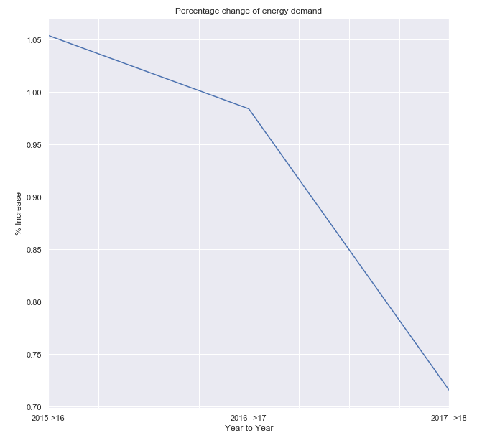
How did demand change (2015 ->18)?
Demand has been increasing at a slowing rate……
Growth Rate 2015 – 2016 = 1.1%
Growth Rate 2017-2018 = 0.7%

Slide 14
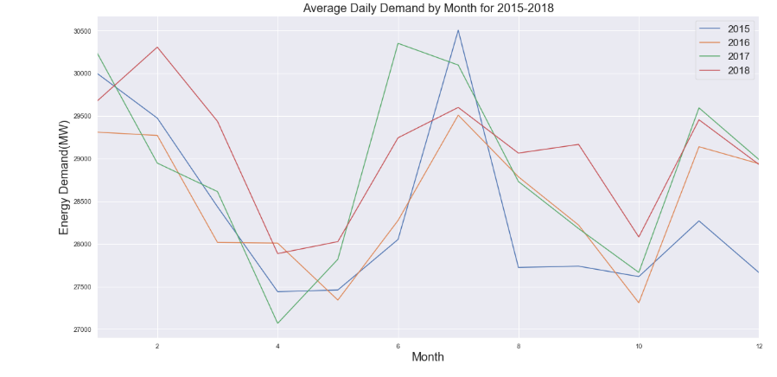
How does demand vary by month?
Observations
Similar annual pattern
Two peaks:
- Winter (January)
- Summer (July)
Two lows:
- Spring (April)
- Fall (October)
Decreases and increases linearly between the seasons

Slide 15
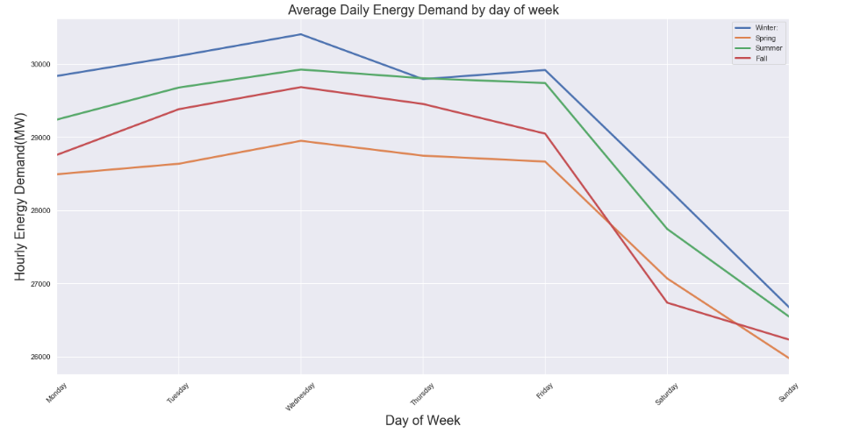
How does demand vary across the week?
Observations
Similar pattern across the 4 seasons:
Peak on Wednesday
Small decrease into Friday
Steep decrease to Saturday
Same rate of decrease into Sunday
Steep increase into Monday
Slight differences…….

Slide 16
How does demand vary across the week?
Observations
Winter & Fall: Slight differences compared to average pattern
Winter: Increase in demand between Thursday and Friday.
Fall: Flatter decrease between Saturday and Sunday.

Slide 17
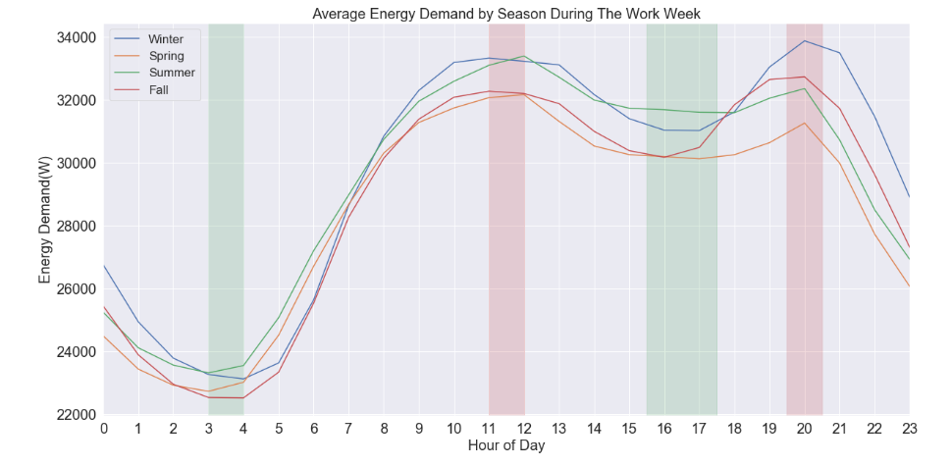
How does intraday hourly demand change?
Observations
Similar pattern during 4 seasons
Two lows and two peaks:
Let’s walk through energy demand during the day

Slide 18
How does intraday hourly demand change?
Observations
1st Low:
3-4am, peak human inactivity (All sleeping).
Usually the lower low
Energy required: Heating/Cooling of homes only + some night shifts work.

Slide 19
How does intraday hourly demand change?
Observations
Linear and steep increase of demand from 4am until 8am/9am.
1st High :
11am/12pm (Peak of human activity)
Peak of the day during Spring/Summer
Energy required: Heating/Cooling of homes + offices + factories + transportation + peak of human activity

Slide 20
How does intraday hourly demand change?
Observations
Small decrease of demand until 4/5pm.
2nd Low:
Shutdown of offices/factories and commute home.
Peak of the day during Winter/Fall
Energy required: Heating/Cooling of homes + offices + factories + transportation + peak of human activity

Slide 21
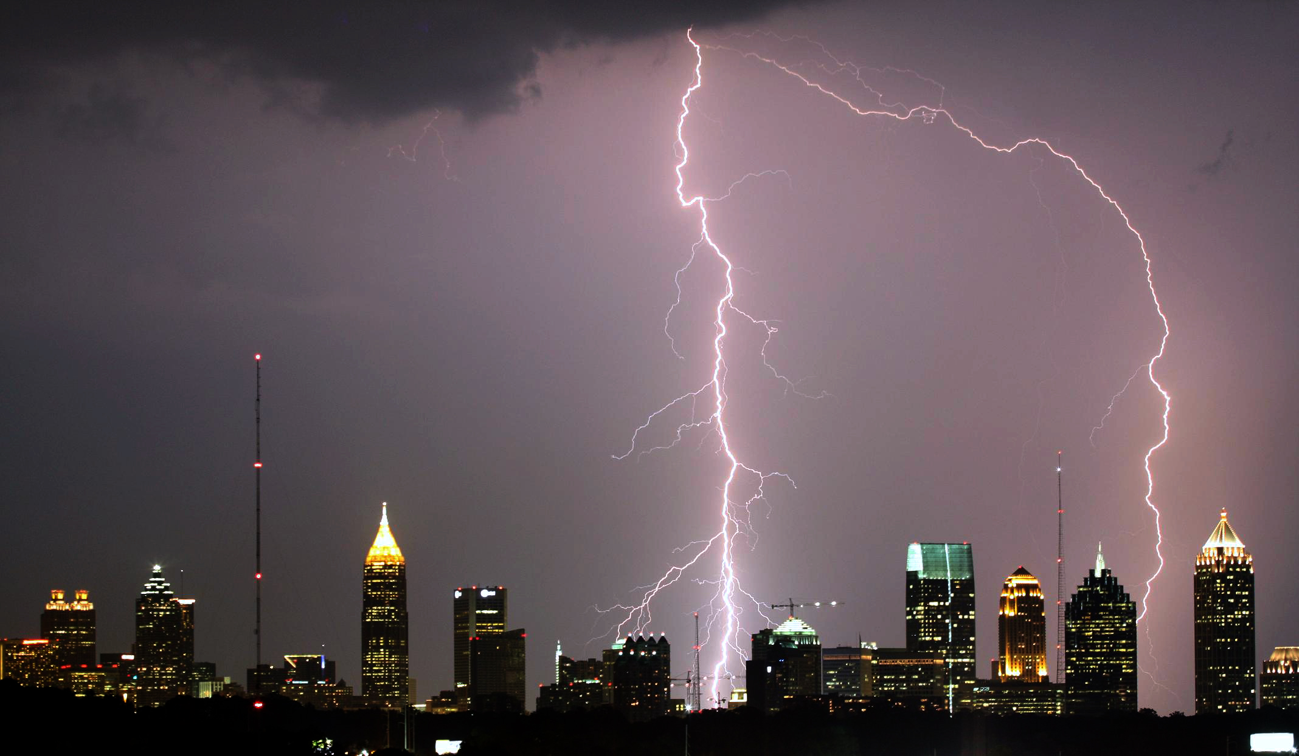
Weather Questions - EDA
1. How do weather features change across the months?
2. How do weather features change across the day?
3. How do weather features correlate to each other?

Slide 22
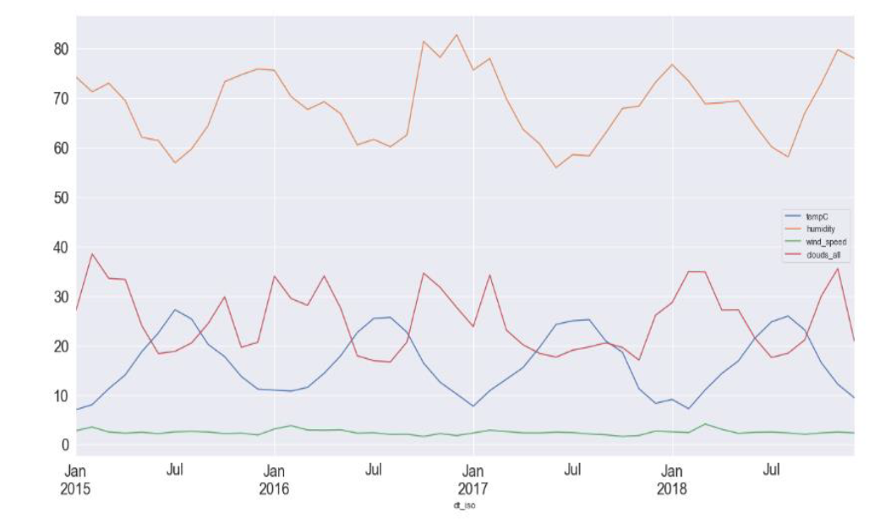
How do weather features change across the months?
Temperature:
Temp(C) & humidity (%)
Humidity and Cloud Formation(%):
Rain, wind speed and pressure analyzed later due different orders of magnitude.

Slide 23
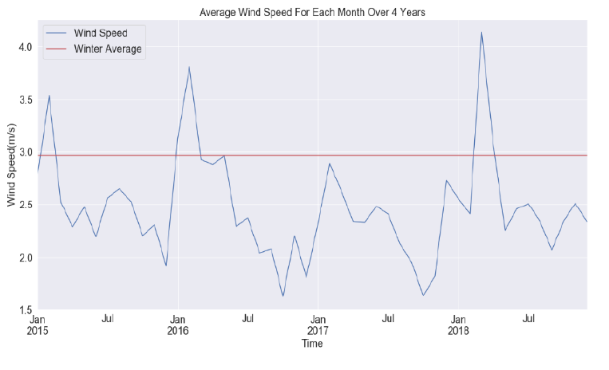
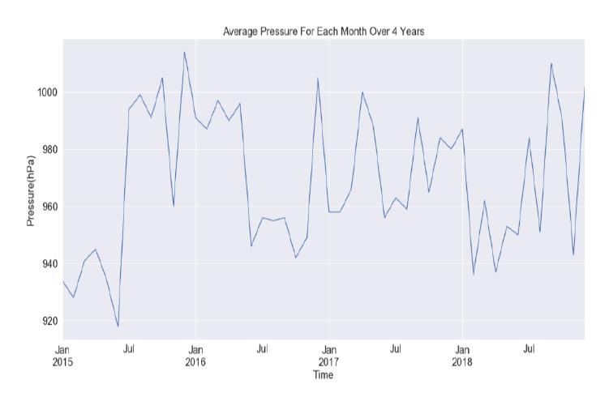
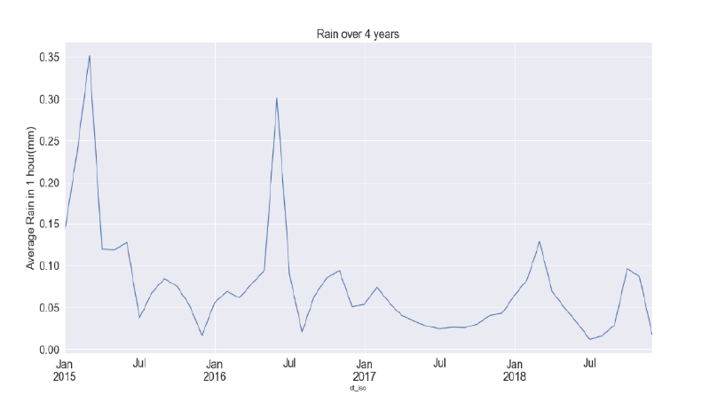
How do weather features change across the months?
Pressure:
No seasonal pattern.
Rain:
Downward trend line.
Peaks in winter 3 out of 4 years.
2016 peak during spring which is uncommon
Wind Speed:
Peak in winter.
The red line is the winter average.
Higher than average peaks for all winters except 2017.

Slide 24
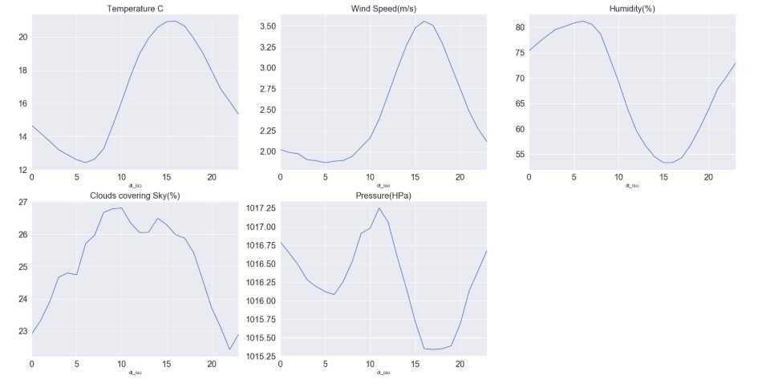
How do weather features change across the day?
Temperature:
Increase starts 5am
Peaks at 3 pm
Decreasing from sunset until 5am.
Wind Speed: Similar to Temp.
Humidity: Opposes Temp.
Cloud Formation:
High at 10am
Plateau until 3 pm
Decreasing until 9pm
increasing until 10am.
Pressure:
1st High at 11am
1st low at 5pm
2nd high at 12am
2nd low at 6am.

Slide 25
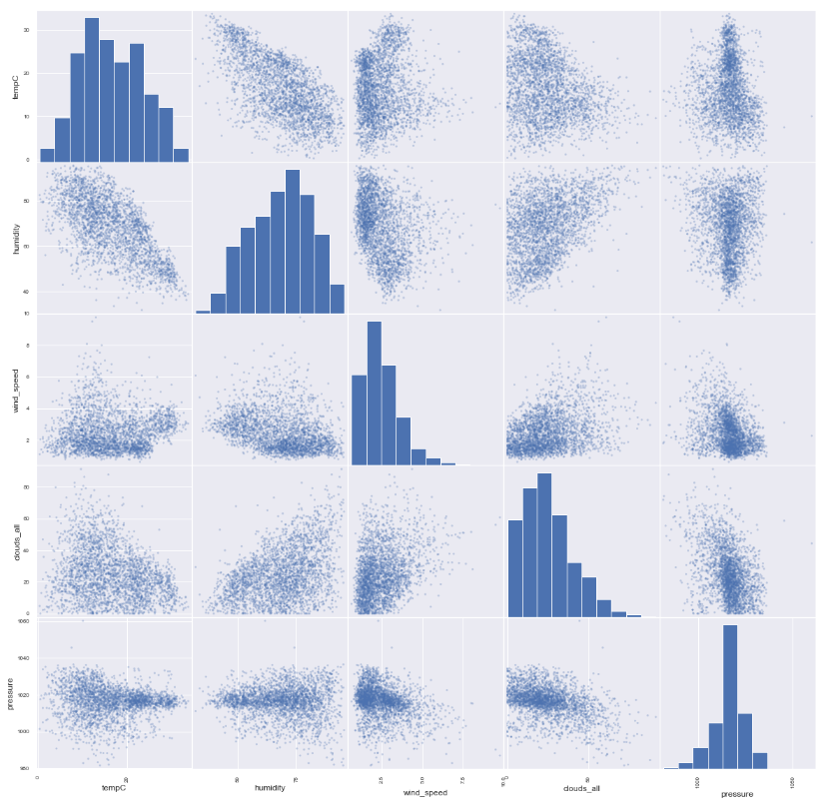
How do weather features correlate to each other?
Negative Relationships:
Temperature and Humidity.
Temperature and Cloud formation
Wind Speed and Humidity
Pressure and Cloud formation.
Pressure and Wind Speed.
Positive Relationships:
Wind Speed and Cloud formation
Humidity and Cloud formation

Slide 26

Demand & Weather Relationship - EDA
How do weather features affect demand?

Slide 27
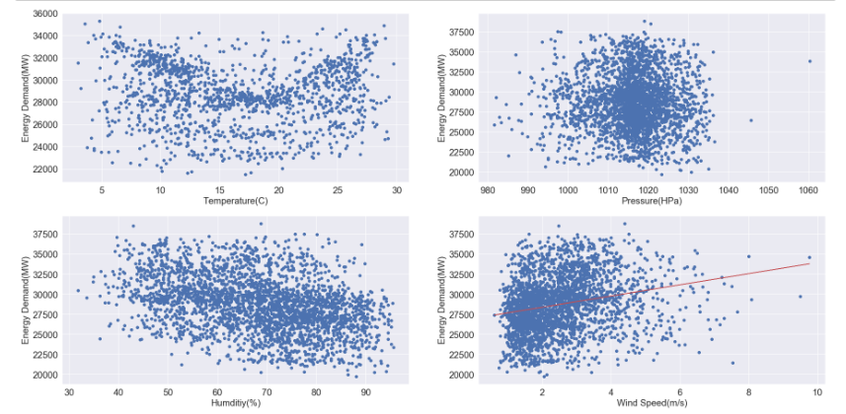
Weather Features vs Demand
Temperature:
Parabolic relationship with demand.
Demand peaks at 5C and 30C temperature.
Demand lows at around 15-20C.
Pressure:
Demand &pressure do not seem to be correlated.
Humidity:
Parabolically relationship
Expected as Temperature & Humidity are negatively related.
Wind Speed:
A highly variant positive correlation is evident with energy demand.

Slide 28
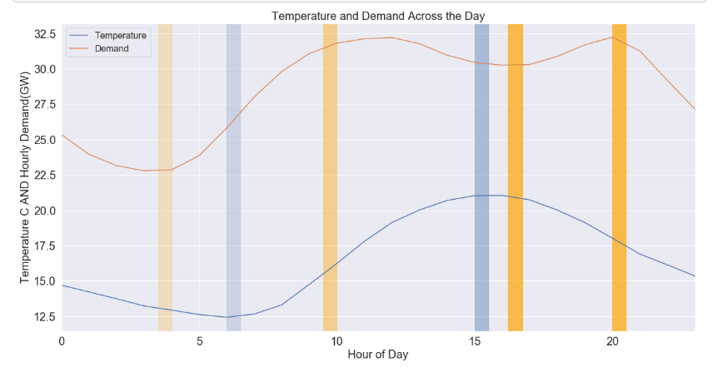
Demand and Weather During the Day
Temperature low 6am <-> Demand low 4am.
• Temperature high 3pm <-> Demand high 10am.
• Temperature decreasing until 6am -- Demand low at 4:30pm.
• Temperature decreasing until 6am -- Demand hits a high at 8pm.
This analysis suggests that intraday demand movements are not fully predicted by temperature changes.

Slide 29

Statistical Tests
Questions that will aid understanding of data :
1. How does correlation between Temperature and Demand Change at different Temps?
2. Can the Seasonal cycle be defined by 26 weeks ?

Slide 30

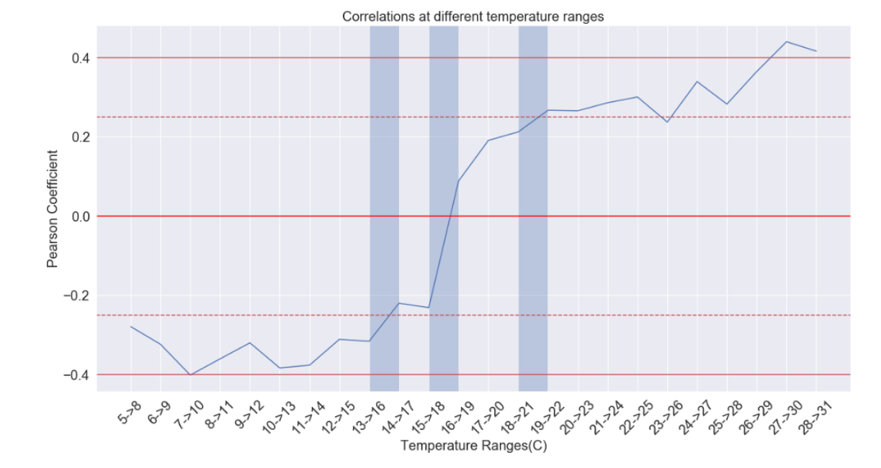
How does correlation between Temperature and Demand Change?
Correlation increases above -0.25 from the low (-0.4) between 13-17C.
Correlation crosses 0 at 15-19C which means the low of demand occurs at this range.
Correlation increase above 0.25 at between 18->22C.
Correlation is flat at temperatures below 15C at -0.4 and at temperatures above 26C.

Slide 31
Can the Seasonal Cycle be defined by 26 weeks ?
Seasons: Winter, Spring, Summer, Fall = 52 weeks
High Demand : Winter and Summer
Low Demand : Fall and Spring
Condition 1: Winter & Summer have same demand mean and standard deviation distribution
Condition 2: Fall & Spring have same demand mean and standard deviation distribution
If condition 1 & 2 met, then seasonal cycle can be defined as 26 weeks, -> more data per season.
Testing 4 hypotheses and all have the be True for the assumption to be True.
Null Hypothesis 1: Winter & Summer have same demand mean distribution
Null Hypothesis 2: Winter & Summer have same demand standard deviation distribution
Null Hypothesis 3: Fall & Spring have same demand mean distribution
Null Hypothesis 4: Fall & Spring have same demand standard deviation distribution

Slide 32
Testing Hypothesis 1 & 2
Combine the similar demand datasets into one big dataset and compute the combined mean.
Shift mean of individual datasets to have same value as combined mean. This was done by transforming the datasets using the following equation:
𝑇𝑟𝑎𝑛𝑠𝑓𝑜𝑟𝑚𝑒𝑑 𝐼𝑛𝑑𝑖𝑣𝑢𝑑𝑎𝑙 𝑆𝑒𝑎𝑠𝑜𝑛 𝐷𝑎𝑡𝑎𝑠𝑒𝑡 (𝑨𝒓𝒓𝒂𝒚)
= 𝑂𝑏𝑠𝑒𝑟𝑣𝑒𝑑 𝐼𝑛𝑑𝑖𝑣𝑖𝑑𝑢𝑎𝑙 𝑆𝑒𝑎𝑠𝑜𝑛 𝐷𝑒𝑚𝑎𝑛𝑑(𝑨𝒓𝒓𝒂𝒚) − 𝑂𝑏𝑠𝑒𝑟𝑣𝑒𝑑 𝐼𝑛𝑑𝑖𝑣𝑖𝑑𝑢𝑎𝑙 𝑆𝑒𝑎𝑠𝑜𝑛 𝐷𝑒𝑚𝑎𝑛𝑑 𝑀𝑒𝑎𝑛(𝑰𝒏𝒕𝒆𝒈𝒆𝒓) + 𝐶𝑜𝑚𝑏𝑖𝑛𝑒𝑑 𝑀𝑒𝑎𝑛(𝑰𝒏𝒕𝒆𝒈𝒆𝒓)
Bootstrap 10,000 mean replicates for each transformed season from bootstrapping samples.
Find the difference of the 10,000 bootstrapped mean replicates datasets between different seasons. E.g (Winter Means–Summer Means)
Compute the observed difference of the actual means.
Test the observed difference against the bootstrapped differences by counting the number of bootstrapped replicates that are equal to or greater than the observed difference.
Divide the count by the length of the array to obtain the p-value.
For a 95% confidence interval, if the p-value is less than 0.05, we shall reject the null hypothesis.

Slide 33
Testing Hypothesis 3 & 4
To compare the std, we must shift the datasets to achieve similar standard deviations
The transformed dataset can be done using the following:
𝑇𝑟𝑎𝑛𝑠𝑓𝑜𝑟𝑚𝑒𝑑 𝐼𝑛𝑑𝑖𝑣𝑢𝑑𝑎𝑙 𝑆𝑒𝑎𝑠𝑜𝑛 𝐷𝑎𝑡𝑎𝑠𝑒𝑡 (𝑨𝒓𝒓𝒂𝒚) =
𝐶𝑜𝑚𝑏𝑖𝑛𝑒𝑑 𝑆𝑡𝑎𝑛𝑑𝑎𝑟𝑑 𝐷𝑒𝑣𝑖𝑎𝑡𝑖𝑜𝑛(𝑰𝒏𝒕𝒆𝒈𝒆𝒓)𝑂𝑏𝑠𝑒𝑟𝑣𝑒𝑑 𝐼𝑛𝑑𝑖𝑣𝑖𝑑𝑢𝑎𝑙 𝑆𝑡𝑎𝑛𝑑𝑎𝑟𝑑 𝑑𝑒𝑣𝑖𝑎𝑡𝑖𝑜𝑛 (𝑰𝒏𝒕𝒆𝒈𝒆𝒓) × (𝑂𝑏𝑠𝑒𝑟𝑣𝑒𝑑 𝑆𝑒𝑎𝑠𝑜𝑛 𝐷𝑎𝑡𝑎𝑠𝑒𝑡(𝑨𝒓𝒓𝒂𝒚)− 𝑂𝑏𝑠𝑒𝑟𝑣𝑒𝑑 𝑆𝑒𝑎𝑠𝑜𝑛 𝑀𝑒𝑎𝑛(𝑰𝒏𝒕𝒆𝒈𝒆𝒓)) + 𝑂𝑏𝑠𝑒𝑟𝑣𝑒𝑑 𝐼𝑛𝑑𝑖𝑣𝑖𝑑𝑢𝑎𝑙 𝑆𝑒𝑎𝑠𝑜𝑛 𝑀𝑒𝑎𝑛

Slide 34
Hypothesis Results
Null Hypothesis 1,2,3,4 are rejected
All seasons have different mean and std distribution
The season cannot be define by 26 weeks
52 Weeks is the season of choice for modelling.

Slide 35

Modelling

